Slide 1
Input and Interaction
Varalakshmi B D
CG&IP
Computer Science
AIT

Slide 2
Graphical Input
Devices can be described either by
Physical properties
Mouse
Keyboard
Trackball
Logical Properties
What is returned to program via API
A position
An object identifier
Modes
How and when input is obtained
Request or event
‹#›

Slide 3
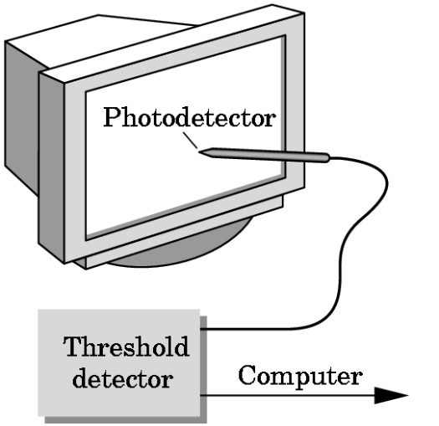
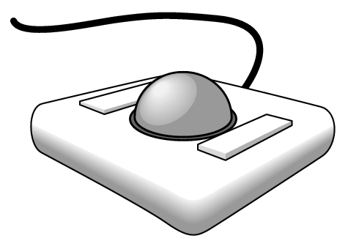
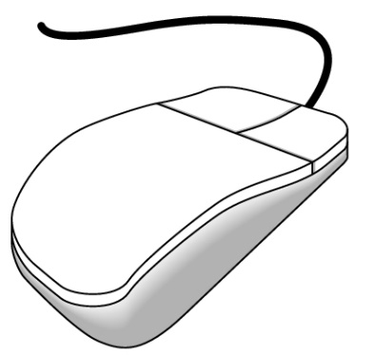
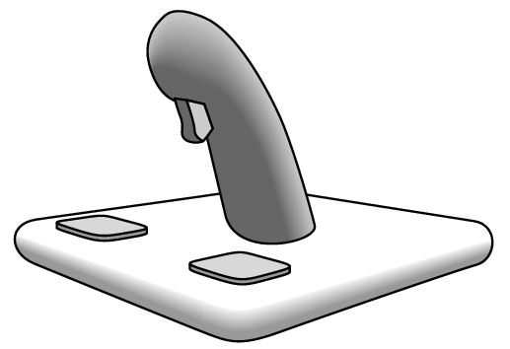
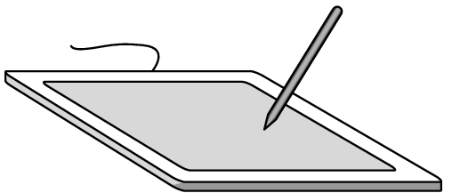
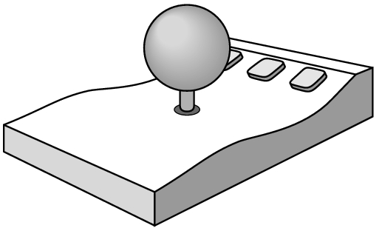
Physical Devices
mouse
trackball
light pen
data tablet
joy stick
space ball
‹#›

Slide 4
Incremental (Relative) Devices
Devices such as the data tablet return a position directly to the operating system
Devices such as the mouse, trackball, and joy stick return incremental inputs (or velocities) to the operating system
Must integrate these inputs to obtain an absolute position
Rotation of wheels in mouse
Roll of trackball
Difficult to obtain absolute position
Can get variable sensitivity
‹#›

Slide 5
Logical Devices
Consider the C and C++ code
C++: cin >> x;
C: scanf (“%d”, &x);
What is the input device?
Can’t tell from the code
Could be keyboard, file, output from another program
The code provides logical input
A number (an int) is returned to the program regardless of the physical device
‹#›

Slide 6
Graphical Logical Devices
Graphical input is more varied than input to standard programs which is usually numbers, characters, or bits
Two older APIs (GKS, PHIGS) defined six types of logical input
Locator: return a position
Pick: return ID of an object
Keyboard: return strings of characters
Stroke: return array of positions
Valuator: return floating point number
Choice: return one of n items
‹#›

Slide 7
Input Modes
Input devices contain a trigger which can be used to send a signal to the operating system
Button on mouse
Pressing or releasing a key
When triggered, input devices return information (their measure) to the system
Mouse returns position information
Keyboard returns ASCII code
‹#›

Slide 8
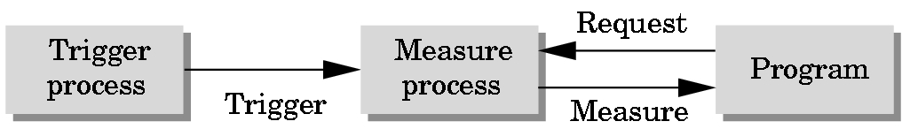
Request Mode
Input provided to program only when user triggers the device
Typical of keyboard input
Can erase (backspace), edit, correct until enter (return) key (the trigger) is depressed
‹#›

Slide 9
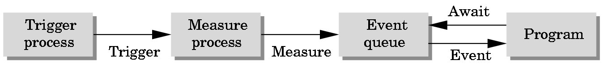
Event Mode
Most systems have more than one input device, each if which can be triggered at an arbitrary time by a user
Each trigger generates an event whose measure is put in an event queue which can be examined by the user program
‹#›

Slide 10
Event Types
Window: resize, expose, iconify
Mouse: click one or more buttons
Motion: move mouse
Keyboard: press or release a key
Idle: nonevent
Define what should be done if no other event is in queue
‹#›

Slide 11
Callbacks
Programming interface for event-driven input
Define a callback function for each type of event the graphics system recognizes
This user-supplied function is executed when the event occurs
GLUT example: glutMouseFunc(mymouse)
mouse callback function
‹#›

Slide 12
GLUT callbacks
GLUT recognizes a subset of the events recognized by any particular window system (Windows, X, Macintosh)
glutDisplayFunc
glutMouseFunc
glutReshapeFunc
glutKeyFunc
glutIdleFunc
glutMotionFunc, glutPassiveMotionFunc
‹#›

Slide 13
GLUT Event Loop
Remember that the last line in main.c for a program using GLUT must be
glutMainLoop();
which puts the program in an infinite event loop
In each pass through the event loop, GLUT
looks at the events in the queue
for each event in the queue, GLUT executes the appropriate callback function if one is defined
if no callback is defined for the event, the event is ignored
‹#›

Slide 14
The display callback
The display callback is executed whenever GLUT determines that the window should be refreshed, for example
When the window is first opened
When the window is reshaped
When a window is exposed
When the user program decides it wants to change the display
In main.c
glutDisplayFunc(mydisplay) identifies the function to be executed
Every GLUT program must have a display callback
‹#›

Slide 15
Posting redisplays
Many events may invoke the display callback function
Can lead to multiple executions of the display callback on a single pass through the event loop
We can avoid this problem by instead using
glutPostRedisplay();
which sets a flag.
GLUT checks to see if the flag is set at the end of the event loop
If set then the display callback function is executed
‹#›

Slide 16
Animating a Display
When we redraw the display through the display callback, we usually start by clearing the window
glClear()
then draw the altered display
Problem: the drawing of information in the frame buffer is decoupled from the display of its contents
Graphics systems use dual ported memory
Hence we can see partially drawn displaya
See the program single_double.c for an example with a rotating cube
‹#›

Slide 17
Double Buffering
Instead of one color buffer, we use two
Front Buffer: one that is displayed but not written to
Back Buffer: one that is written to but not altered
Program then requests a double buffer in main.c
glutInitDisplayMode(GL_RGB | GL_DOUBLE)
At the end of the display callback buffers are swapped
void mydisplay()
{
glClear()
.
/* draw graphics here */
.
glutSwapBuffers()
}
‹#›

Slide 18
Using the idle callback
The idle callback is executed whenever there are no events in the event queue
glutIdleFunc(myidle)
Useful for animations
void myidle() {
/* change something */
t += dt
glutPostRedisplay();
}
Void mydisplay() {
glClear();
/* draw something that depends on t */
glutSwapBuffers();
}
‹#›

Slide 19
Using globals
The form of all GLUT callbacks is fixed
void mydisplay()
void mymouse(GLint button, GLint state, GLint x, GLint y)
Must use globals to pass information to callbacks
float t; /*global */
void mydisplay()
{
/* draw something that depends on t
}
‹#›

Slide 20
The mouse callback
glutMouseFunc(mymouse)
void mymouse(GLint button, GLint state, GLint x, GLint y)
Returns
which button (GLUT_LEFT_BUTTON, GLUT_MIDDLE_BUTTON, GLUT_RIGHT_BUTTON) caused event
state of that button (GL_UP, GLUT_DOWN)
Position in window
‹#›

Slide 21
Positioning
The position in the screen window is usually measured in pixels with the origin at the top-left corner
Consequence of refresh done from top to bottom
OpenGL uses a world coordinate system with origin at the bottom left
Must invert y coordinate returned by callback by height of window
y = h – y;
(0,0)
h
w
‹#›

Slide 22
Obtaining the window size
To invert the y position we need the window height
Height can change during program execution
Track with a global variable
New height returned to reshape callback that we will look at in detail soon
Can also use enquiry functions
glGetIntv
glGetFloatv
to obtain any value that is part of the state
‹#›

Slide 23
Terminating a program
In our original programs, there was no way to terminate them through OpenGL
We can use the simple mouse callback
void mouse(int btn, int state, int x, int y)
{
if(btn==GLUT_RIGHT_BUTTON && state==GLUT_DOWN)
exit(0);
}
‹#›

Slide 24
Using the mouse position
In the next example, we draw a small square at the location of the mouse each time the left mouse button is clicked
This example does not use the display callback but one is required by GLUT; We can use the empty display callback function
mydisplay(){}
‹#›

Slide 25
Drawing squares at cursor location
void mymouse(int btn, int state, int x, int y)
{
if(btn==GLUT_RIGHT_BUTTON && state==GLUT_DOWN)
exit(0);
if(btn==GLUT_LEFT_BUTTON && state==GLUT_DOWN)
drawSquare(x, y);
}
void drawSquare(int x, int y)
{
y=w-y; /* invert y position */
glColor3ub( (char) rand()%256, (char) rand )%256, (char) rand()%256); /* a random color */
glBegin(GL_POLYGON);
glVertex2f(x+size, y+size);
glVertex2f(x-size, y+size);
glVertex2f(x-size, y-size);
glVertex2f(x+size, y-size);
glEnd();
}
‹#›

Slide 26
Using the motion callback
We can draw squares (or anything else) continuously as long as a mouse button is depressed by using the motion callback
glutMotionFunc(drawSquare)
We can draw squares without depressing a button using the passive motion callback
glutPassiveMotionFunc(drawSquare)
‹#›

Slide 27
Using the keyboard
glutKeyboardFunc(mykey)
void mykey(unsigned char key,
int x, int y)
Returns ASCII code of key depressed and mouse location
Note GLUT does not recognize key release as an event
void mykey()
{
if(key == ‘Q’ | key == ‘q’)
exit(0);
}
‹#›

Slide 28
Special and Modifier Keys
GLUT defines the special keys in glut.h
Function key 1: GLUT_KEY_F1
Up arrow key: GLUT_KEY_UP
if(key == ‘GLUT_KEY_F1’ ……
Can also check of one of the modifiers
GLUT_ACTIVE_SHIFT
GLUT_ACTIVE_CTRL
GLUT_ACTIVE_ALT
is depressed by
glutGetModifiers()
Allows emulation of three-button mouse with one- or two-button mice
‹#›

Slide 29
Reshaping the window
We can reshape and resize the OpenGL display window by pulling the corner of the window
What happens to the display?
Must redraw from application
Two possibilities
Display part of world
Display whole world but force to fit in new window
Can alter aspect ratio
‹#›

Slide 30
Reshape possibilities
original
reshaped
‹#›

Slide 31
The Reshape callback
glutReshapeFunc(myreshape)
void myreshape( int w, int h)
Returns width and height of new window (in pixels)
A redisplay is posted automatically at end of execution of the callback
GLUT has a default reshape callback but you probably want to define your own
The reshape callback is good place to put camera functions because it is invoked when the window is first opened
‹#›

Slide 32
Example Reshape
This reshape preserves shapes by making the viewport and world window have the same aspect ratio
void myReshape(int w, int h)
{
glViewport(0, 0, w, h);
glMatrixMode(GL_PROJECTION); /* switch matrix mode */
glLoadIdentity();
if (w <= h)
gluOrtho2D(-2.0, 2.0, -2.0 * (GLfloat) h / (GLfloat) w,
2.0 * (GLfloat) h / (GLfloat) w);
else gluOrtho2D(-2.0 * (GLfloat) w / (GLfloat) h, 2.0 *
(GLfloat) w / (GLfloat) h, -2.0, 2.0);
glMatrixMode(GL_MODELVIEW); /* return to modelview mode */
}
‹#›

Slide 33
Toolkits and Widgets
Most window systems provide a toolkit or library of functions for building user interfaces that use special types of windows called widgets
Widget sets include tools such as
Menus
Slidebars
Dials
Input boxes
But toolkits tend to be platform dependent
GLUT provides a few widgets including menus
‹#›

Slide 34
Menus
GLUT supports pop-up menus
A menu can have submenus
Three steps
Define entries for the menu
Define action for each menu item
Action carried out if entry selected
Attach menu to a mouse button
‹#›

Slide 35
Defining a simple menu
In main.c
menu_id = glutCreateMenu(mymenu);
glutAddmenuEntry(“clear Screen”, 1);
gluAddMenuEntry(“exit”, 2);
glutAttachMenu(GLUT_RIGHT_BUTTON);
clear screen
exit
entries that appear when
right button depressed
identifiers
‹#›

Slide 36
Menu actions
Menu callback
Note each menu has an id that is returned when it is created
Add submenus by
glutAddSubMenu(char *submenu_name, submenu id)
void mymenu(int id)
{
if(id == 1) glClear();
if(id == 2) exit(0);
}
entry in parent menu
‹#›

Slide 37
Other functions in GLUT
Dynamic Windows
Create and destroy during execution
Subwindows
Multiple Windows
Changing callbacks during execution
Timers
Portable fonts
glutBitmapCharacter
glutStrokeCharacter
‹#›

Slide 38
Picking
Identify a user-defined object on the display
In principle, it should be simple because the mouse gives the position and we should be able to determine to which object(s) a position corresponds
Practical difficulties
Pipeline architecture is feed forward, hard to go from screen back to world
Complicated by screen being 2D, world is 3D
How close do we have to come to object to say we selected it?
‹#›

Slide 39
Three Approaches
Hit list
Most general approach but most difficult to implement
Use back or some other buffer to store object ids as the objects are rendered
Rectangular maps
Easy to implement for many applications
See paint program in text
‹#›

Slide 40
Rendering Modes
OpenGL can render in one of three modes selected by glRenderMode(mode)
GL_RENDER: normal rendering to the frame buffer (default)
GL_FEEDBACK: provides list of primitives rendered but no output to the frame buffer
GL_SELECTION: Each primitive in the view volume generates a hit record that is placed in a name stack which can be examined later
‹#›

Slide 41
Selection Mode Functions
glSelectBuffer(): specifies name buffer
glInitNames(): initializes name buffer
glPushName(id): push id on name buffer
glPopName(): pop top of name buffer
glLoadName(id): replace top name on buffer
id is set by application program to identify objects
‹#›

Slide 42
Using Selection Mode
Initialize name buffer
Enter selection mode (using mouse)
Render scene with user-defined identifiers
Reenter normal render mode
This operation returns number of hits
Examine contents of name buffer (hit records)
Hit records include id and depth information
‹#›

Slide 43
Selection Mode and Picking
As we just described it, selection mode won’t work for picking because every primitive in the view volume will generate a hit
Change the viewing parameters so that only those primitives near the cursor are in the altered view volume
Use gluPickMatrix (see text for details)
‹#›

Slide 44
Using Regions of the Screen
Many applications use a simple rectangular arrangement of the screen
Example: paint/CAD program
Easier to look at mouse position and determine which area of screen it is in that using selection mode picking
tools
menus
drawing area
‹#›

Slide 45
Using another buffer and colors for picking
For a small number of objects, we can assign a unique color (often in color index mode) to each object
We then render the scene to a color buffer other than the front buffer so the results of the rendering are not visible
We then get the mouse position and use glReadPixels() to read the color in the buffer we just wrote at the position of the mouse
The returned color gives the id of the object
‹#›

Slide 46
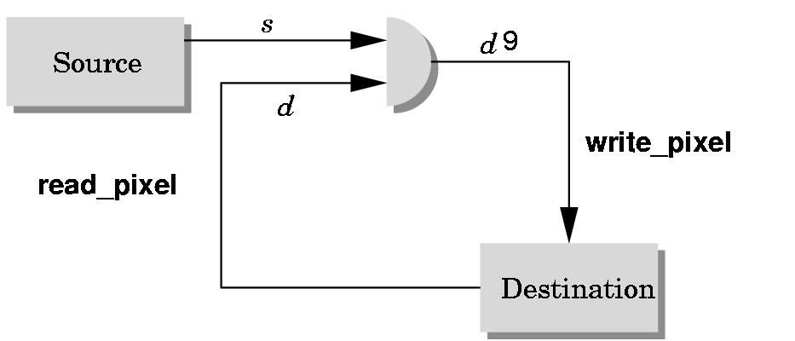
Writing Modes
bitwise logical operation
application
‘
frame buffer
‹#›

Slide 47
XOR write
Usual (default) mode: source replaces destination (d’ = s)
Cannot write temporary lines this way because we cannot recover what was “under” the line in a fast simple way
Exclusive OR mode (XOR) (d’ = d ⊕ s)
x ⊕ y ⊕ x =x
Hence, if we use XOR mode to write a line, we can draw it a second time and line is erased!
‹#›

Slide 48
Rubberbanding
Switch to XOR write mode
Draw object
For line can use first mouse click to fix one endpoint and then use motion callback to continuously update the second endpoint
Each time mouse is moved, redraw line which erases it and then draw line from fixed first position to to new second position
At end, switch back to normal drawing mode and draw line
Works for other objects: rectangles, circles
‹#›

Slide 49
Rubberband Lines
second point
first point
draw line with mouse
in XOR mode
initial display
mouse moved to
new position
original line redrawn
with XOR
new line drawn
with XOR
‹#›

Slide 50
XOR in OpenGL
There are 16 possible logical operations between two bits
All are supported by OpenGL
Must first enable logical operations
glEnable(GL_COLOR_LOGIC_OP)
Choose logical operation
glLogicOp(GL_XOR)
glLogicOp(GL_COPY) (default)
‹#›

Slide 51
Immediate and Retained Modes
Recall that in a standard OpenGL program, once an object is rendered there is no memory of it and to redisplay it, we must re-execute the code for it
Known as immediate mode graphics
Can be especially slow if the objects are complex and must be sent over a network
Alternative is define objects and keep them in some form that can be redisplayed easily
Retained mode graphics
Accomplished in OpenGL via display lists
‹#›

Slide 52
Display Lists
Conceptually similar to a graphics file
Must define (name, create)
Add contents
Close
In client-server environment, display list is placed on server
Can be redisplayed without sending primitives over network each time
‹#›

Slide 53
Display List Functions
Creating a display list
GLuint id;
void init( void )
{
id = glGenLists( 1 );
glNewList( id, GL_COMPILE );
/* other OpenGL routines */
glEndList();
}
Call a created list
void display( void )
{
glCallList( id );
}
‹#›

Slide 54
Display Lists and State
Most OpenGL functions can be put in display lists
State changes made inside a display list persist after the display list is executed
Can avoid unexpected results by using glPushAttrib and glPushMatrix upon entering a display list and glPopAttrib and glPopMatrix before exiting
‹#›

Slide 55

Hierarchy and Display Lists
Consider model of a car
Create display list for chassis
Create display list for wheel
glNewList( CAR, GL_COMPILE );
glCallList( CHASSIS );
glTranslatef( … );
glCallList( WHEEL );
glTranslatef( … );
glCallList( WHEEL );
…
glEndList();
‹#›

